Slide 1
LEVEL 4/5 GROUP 10
THOMAS MCLAREN
JAMIE OWERS
EDUARD IABLONSCHI
EDWARD PHILLIPS

Slide 2
Final Game

Slide 3
Play Testing Resolutions
Feedback Solution
Gameplay gets repetitive – Included choice of projectile
Doesn’t appeal to all genders – Added choice of female character
Similar to other mobile games – Designed around Pirate theme
Notes:
Talk about this is the feedback from players after their initial first experience player our game. They had no instructions or where told what the game was at all.

Slide 4
Design Lesson
The game mechanics have to be coded within the time frame
Notes:
Mention the slow down issue seems to occur when animations are implemented into the game. Also that the animations for characters have been produced in art form. However they just need to be implemented without any drop in frame rates during gameplay, which effects the player experience.

Slide 5
Programming Lesson
Don’t add untested additional features and overwrite game project saves
Animations can cause freezing or slow downs during gameplay
Notes:
Mention the slow down issue seems to occur when animations are implemented into the game. Also that the animations for characters have been produced in art form. However they just need to be implemented without any drop in frame rates during gameplay, which effects the player experience.

Slide 6
Management Lesson
Don’t underestimate group members abilities
Setting a routine is key for effective workflow
Notes:
Mention the slow down issue seems to occur when animations are implemented into the game. Also that the animations for characters have been produced in art form. However they just need to be implemented without any drop in frame rates during gameplay, which effects the player experience.

Slide 7

Emails
Tom McLaren 70
Jamie Owers 26
Eduard Phillips 11
Eduard Lablonshi 6
Notes:
Mention the slow down issue seems to occur when animations are implemented into the game. Also that the animations for characters have been produced in art form. However they just need to be implemented without any drop in frame rates during gameplay, which effects the player experience.

Slide 8
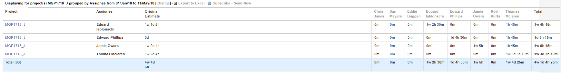
Jira Project Pivot Report

Slide 9
Logged Hours
Tom McLaren Estimated: 60h Logged: 67h 10m
Jamie Owers Estimated: 60h Logged: 46h 45m
Eduard Lablonshi Estimated: 54h Logged: 44h 15m
Edward Phillips Estimated: 24h Logged: 14h 15m

Slide 10
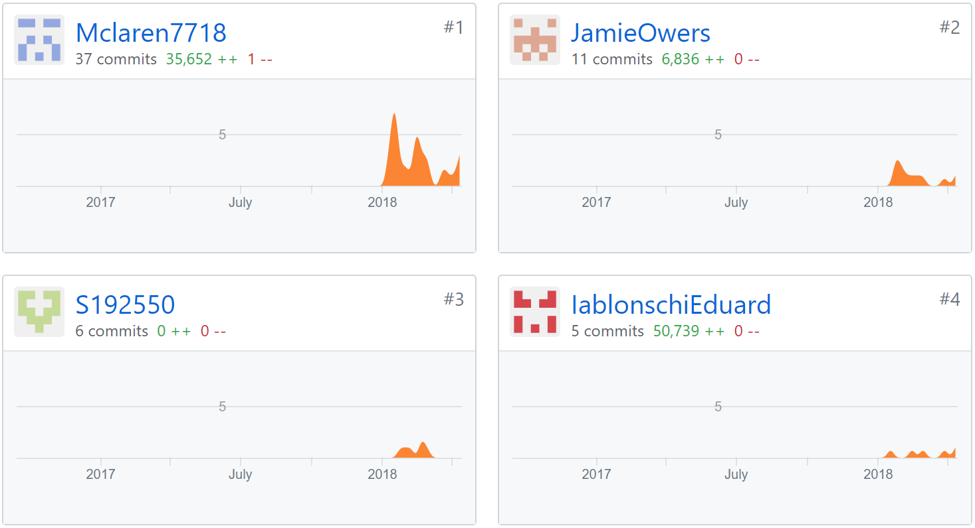
GitHub Commits

Slide 11

ANY QUESTIONS?

